Slide 1
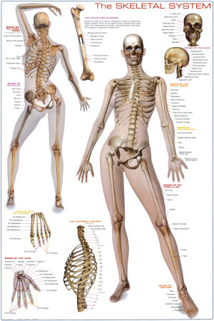
Chapter 7
The Skeletal System

Slide 2
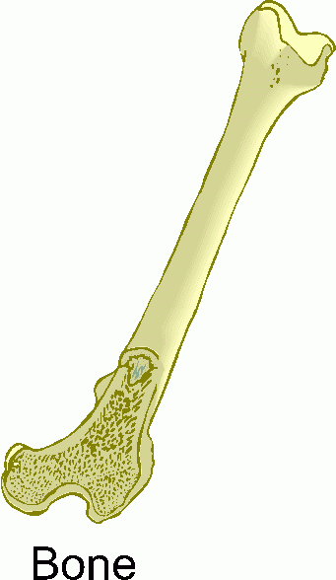
Introduction
Individual bones are the organs of the skeleton system
Bone contains very active tissues

Slide 3
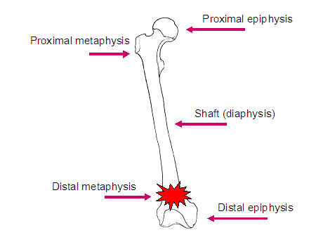
Bone Structure
Bone structure reflects its function
Parts of a long bone
Epiphyses:
Located at each end
Covered by articular cartilage
Articulates (forms joint) with other bones
Diaphysis:
Shaft of bone

Slide 4
Bone Structure Cont.
Parts of a long bone cont.
Periosteum
Covers bone
Mostly found on diaphysis
Compact Bone
Provides strength and resistance to bending
Spongy Bone
Provides strength where needed and reduces weight of bone
Medulllary Cavity
In diaphysis, it’s the area filled with marrow

Slide 5
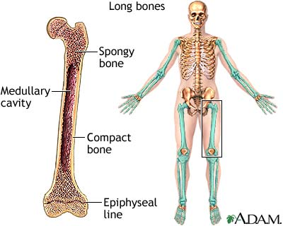

Slide 6
Microscopic Structure
Osteocytes
Mature bone cells
Lacunae
Bony chambers
Processes
Bony projections that provide a site for ligament and tendon attachment

Slide 7
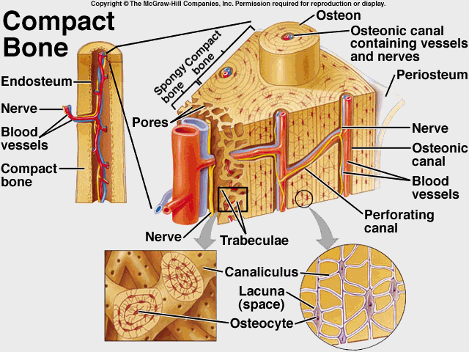
Microscopic Structure Cont.
Osteons
Found in compact bone
Are cemented together to form cylinder shaped units (Haversian System)

Slide 8
Microscopic Structure Cont.
Osteonic Canals (Haversian Canals)
Contain blood vessels that nourish the cells of the osteons
Spongy bone is nourished by diffusion from the surface of the thin bony plates.

Slide 9
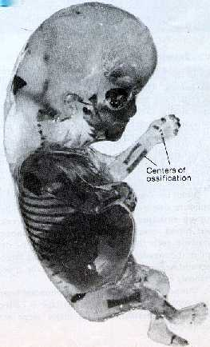
Bone Development and Growth
Intramembranous Bones
Develop from layers of connective tissues
Osteoblasts within the membranous layers form bone tissue

Slide 10
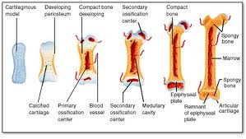
Bone Growth and Development Cont.
Endochondral Bones
Developed first as hyaline cartilage to be later replaced by bone tissue
Primary Ossification (creation of new bone tissue) center appears in the diaphysis, Secondary Oss. In epiphysis.

Slide 11
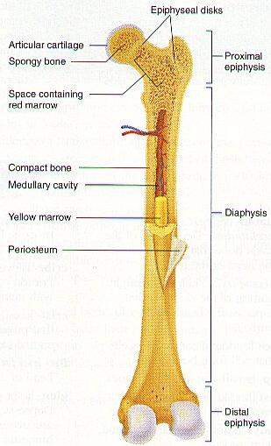
Bone Growth and Development Cont.
Epiphyseal Disk
Division between primary and secondary ossification centers
Responsible for lengthening bone
Bone continues to lengthen until disks ossify.
Growth in thickness is due to intramembranous ossification beneath periosteum
If Epi. Disk is damaged before ossified, it can cause premature growth ending.

Slide 12
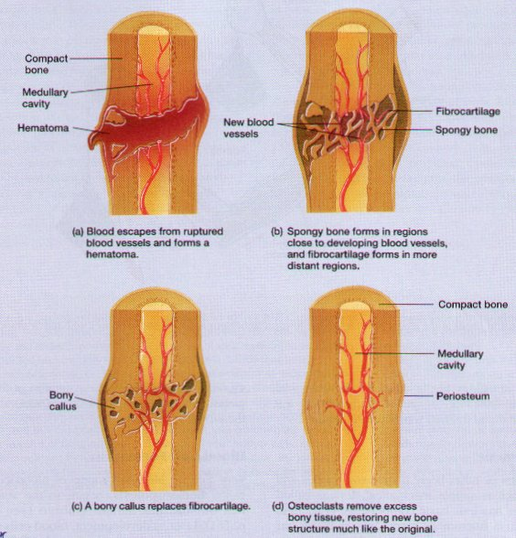
Repair of Bone Fracture

Slide 13
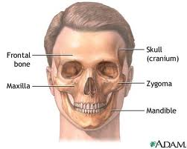
Bone Function
5 Functions
1. Support
2. Protection
Bones shape and form body structures
Bones support and protect softer, underlying tissues

Slide 14
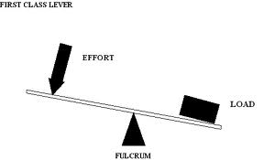
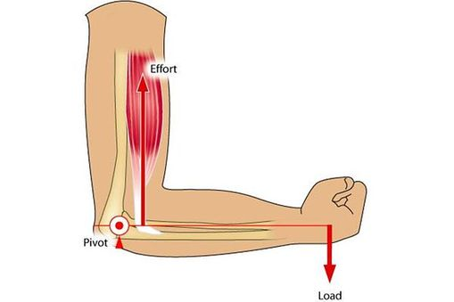
Bone Function Cont.
3. Body Movement
Bones and muscles function together as levers
A lever consists of a rod, pivot (fulcrum), a movable weight, and a force that supplies energy.

Slide 15
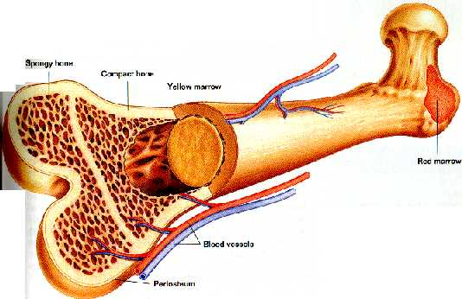
Bone Function Cont.
4. Blood Cell Formation
Hematopoiesis (development of blood cells)
At different ages, hematopoiesis occurs in the yolk sac, liver and spleen, and red bone marrow.
Red Bone marrow produces red blood cells (RBC’s), white blood cells (WBC’s) and blood platelets
Yellow Marrow stores
fat

Slide 16
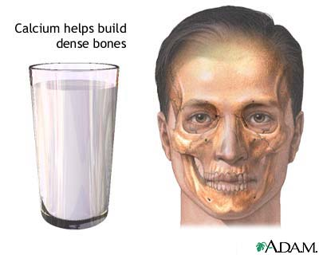
Bone Function Cont.
5. Storage of Inorganic Salts
Intercellular material of bone tissue contains large quantities of calcium phosphate.
When blood calcium is low, osteoclasts break down bone, when blood calcium is high, osteoblasts build bone.
Bone stores small amounts of
magnesium, sodium, potassium
and carbonate ions.

Slide 17
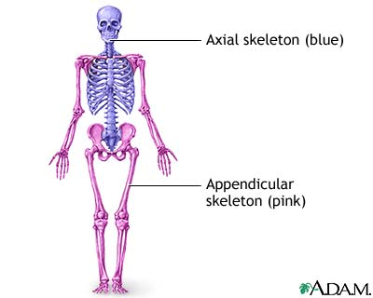
Skeletal Organization p. 140-149
Axial Portion
Skull
Hyoid bone
Vertebral column
Thoracic cage
Appendicular Portion
Pectoral girdle
Upper limbs
Pelvic girdle
Lower limbs

Slide 18
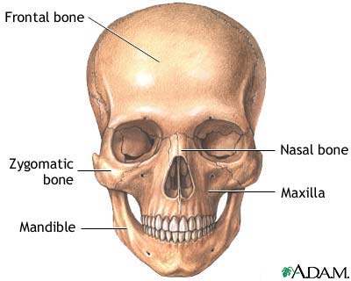
Skull
Consists of 22 bones
8 cranial
13 facial
1 mandible

Slide 19
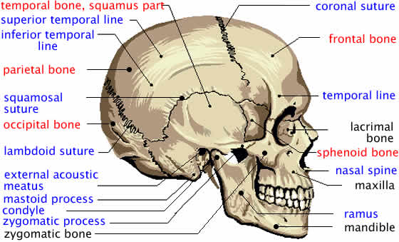
Cranium
Encloses and protects the brain
Some bones contain air filled sinuses
Include
Frontal
Parietal
Occipital
Temporal
Sphenoid
Ethmoid

Slide 20
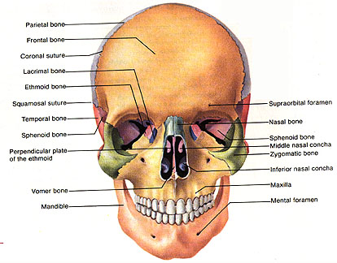
Facial Skeleton
Provides the basic shape of face and attachments for muscles
Includes:
Maxillary
Palatine
Zygomatic
Lacriminal
Nasal
Vomer
Inferior nasal conchae
mandible

Slide 21
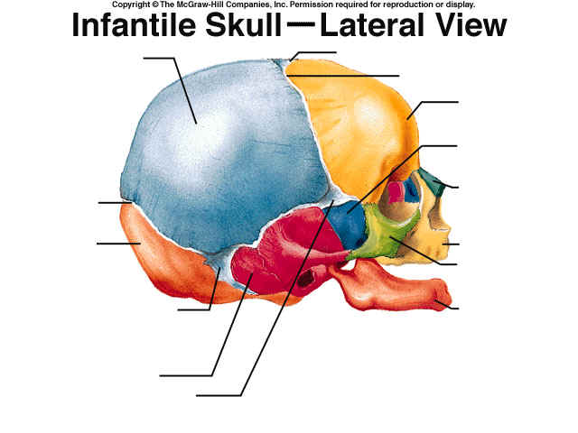
Infantile Skull
Fontanels separate incompletely developed bones
Proportions of the infantile skull are different from those of an adult skull.

Slide 22
Table 7.2 Skeletal Structure Terms
Condyle
Definition: A rounded process that usually articulates with another bone
Example: Occipital condyle of occipital bone
Crest
Defintion: A narrow, ridge-like projection
Example: Iliac crest of ilium
Epicondyle
Defintion: A projection situated above a condyle
Example: Medial epicondyle of humerus
Facet
Definition: A small, nearly flat surface
Example: Rib-facet of thoracic vertebra
Fontanel
Definition: A soft spot in the skull where membranes cover the spaces between bones
ExampleAnterior fontanel between frontal and parietal bones

Slide 23
Table 7.2 Skeletal Structure Terms Cont.
Foramen
Definition: An opening through a bone that usually is a passageway for blood vessels, nerves, or ligaments
Example: Foramen magnum of occipital bone
Fossa
Definition: A relatively deep pit or depression
Example: Olecranon fossaof humerus
Fovea
Definition: A tiny pit or depression
Example: Fovea capitis of femur
Head
Definition: An enlargement of the end of a bone
Example: Head of humerus
Meatus
Definition: A tube-like passageway within a bone
Example: External auditory meatus of ear

Slide 24
Table 7.2 Skeletal Structure Terms Cont.
Process
Definition: A prominent projection on a bone
Example: Mastoid process of temporal bone
Sinus
Definition: A cavity within a bone
Example: Frontal sinus of frontal bone
Spine
Definition: A thorn-like projection
Example: Spine of scapula
Suture
Definition: An interlocking line of union between bones
Example: Lambdoidal suture between occipital and parietal bones
Trochanter
Definition: A relatively large process
Example: Greater trochanter of femur

Slide 25
Table 7.2 Skeletal Structure Terms Cont.
Tubercle
Definition: A small, knob-like process
Example: Greater tubercle of humerus
Tuberosity
Definition: A knob-like process usually larger than a tubercle
Example: Radial Tuberosity of radius

Slide 26
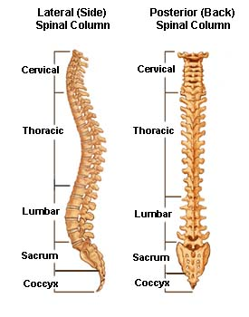
Vertebral Column p. 149-157
Extends from skull to the pelvis
Protects the spinal cord
Composed of vertebrae
Separated by intervertebral disks
Has four curvatures

Slide 27
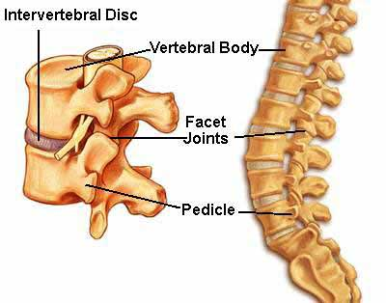
Typical Vertebra
Consists of:
A body
A bony arch (surrounds spinal cord)
Contains notches on upper and lower surfaces that provide intervertebral foramina through which spinal nerves pass.

Slide 28
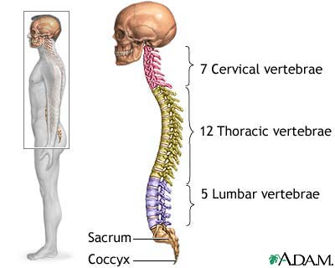
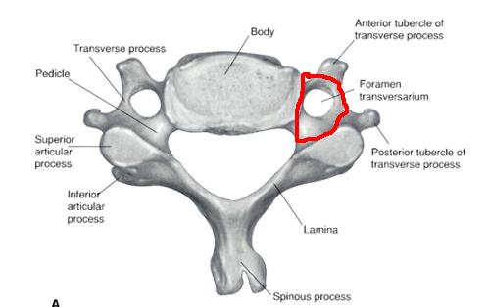
Cervical Vertebrae (7)
Atlas
1st vertebra-supports and balances head
Axis
2nd vertebra-contains dens that provide intervertebral foramina through which spinal nerves pass
Contains Transverse Process which bears the transverse foramina

Slide 29
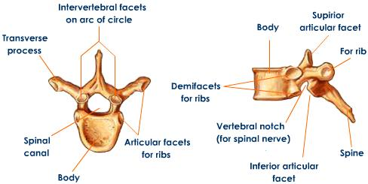
Thoracic Vertebrae (12)
Larger than cervical
Contains facets on the sides that articulate with the ribs

Slide 30
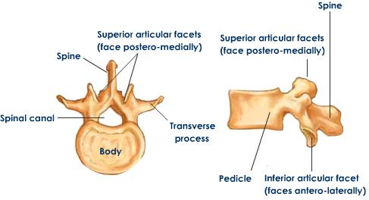
Lumbar Vertebrae (5)
Vertebral Bodies are large and strong
Support more body weight than other vertebrae

Slide 31
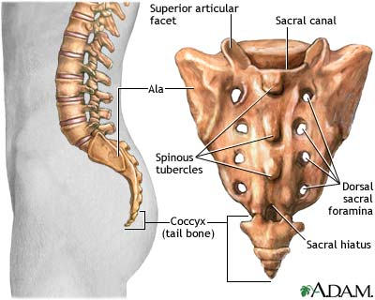
Saccrum
Is a triangular structure formed of five fused vertebrae
Vertebral foramina form the sacral canal

Slide 32
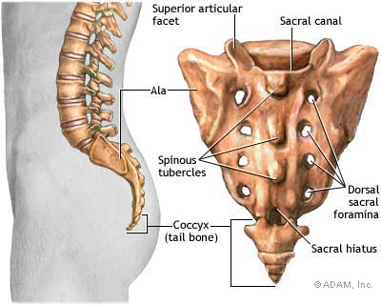
Coccyx
Composed of four fused vertebrae
Forms the lowest part of vertebral column
Your TAILBONE!

Slide 33
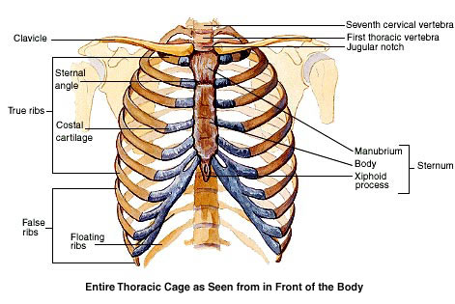
Thoracic Cage
Includes:
Ribs
Thoracic vertebra
Sternum
Costal cartilages
Supports the shoulder girdle and arms
Protects visceral organs
Functions in breathing

Slide 34
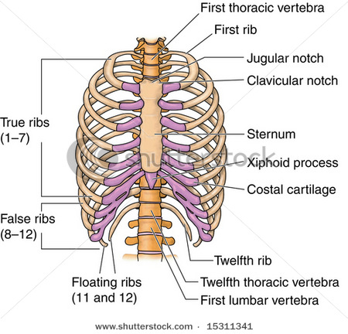
Ribs
12 Pairs are attached to the thoracic vertebrae
True Ribs join sternum directly by costal cartilages
False Ribs join indirectly or not at all
Typical rib has a shaft, head, and tubercles that articulate with the vertebrae.

Slide 35
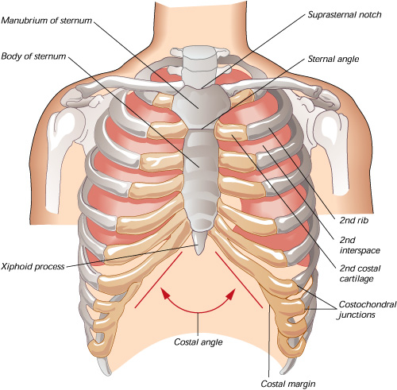
Sternum
Consists of three parts:
Manubrium
Body
Xiphoid process
Articulates with clavicles

Slide 36
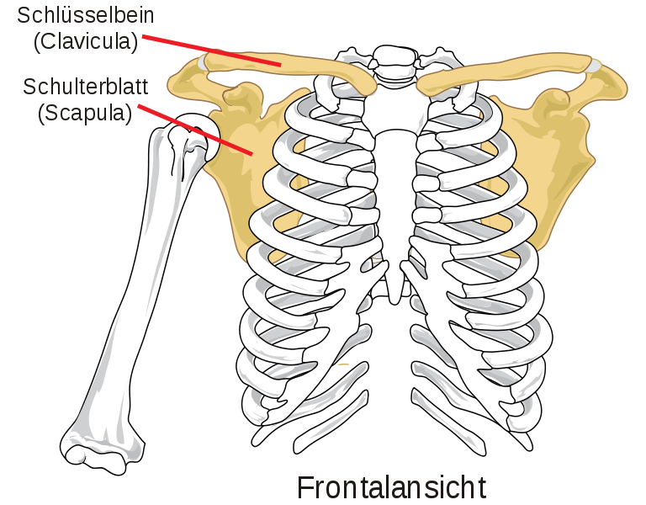
Pectoral Girdle
Composed of:
Two clavicles
Two scapula
Forms an incomplete ring that supports the upper limbs and provides attachment for muscles

Slide 37
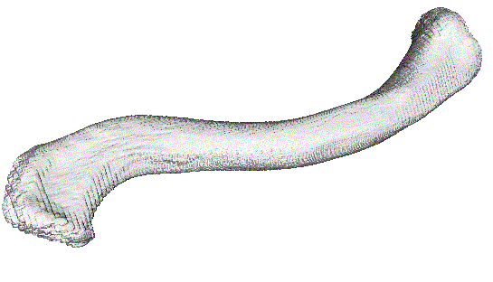
Clavicles
Rod-like bones located between the manubrium and scapulae
Hold the shoulders in place and provide attachment for muscles

Slide 38
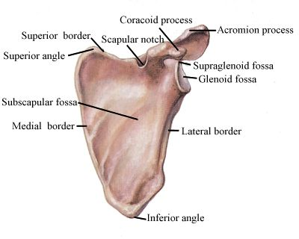
Scapula
Broad, triangular bones
Articulate with the humerus of each upper limb and provide attachment for muscles

Slide 39
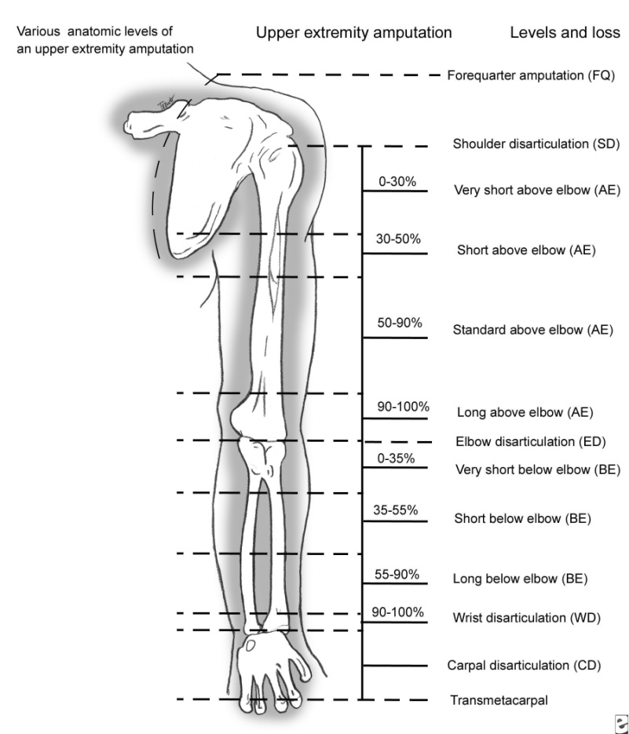
Upper Limbs
Provide framework and attachment for muscles
Function in levers that move the limb and its parts
Contains:
Humerus
Radius
Ulna
Hand

Slide 40
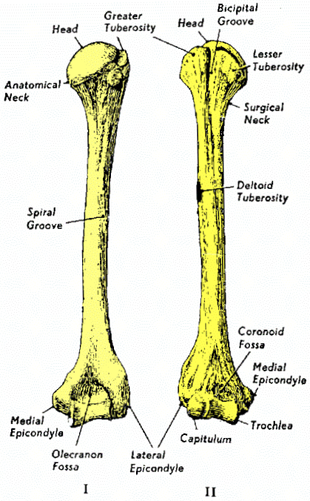
Humerus
Extends from the scapula to the elbow
Articulates with the radius and ulna at elbow

Slide 41
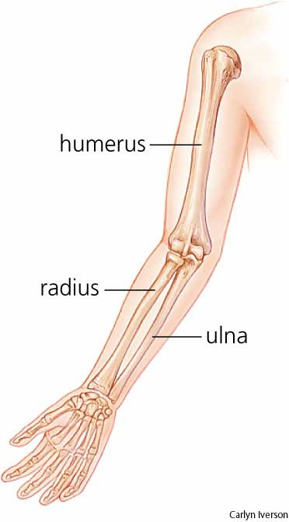
Radius
Located on the thumb side of the forearm between the elbow and wrist
Articulates with humerus, ulna and wrist

Slide 42
Ulna
Longer than radius
Overlaps the humerus posteriorly
Articulates with the radius laterally and with a disk of fibrocartilage inferiorly

Slide 43
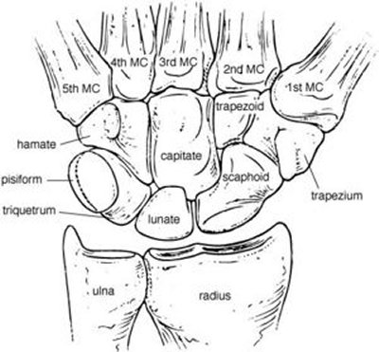
Carpals (8)
Consists of 8 bones:
Lunate
Hamate
Triquetrum
Pisiform
Scaphoid
Capitate
Trapezoid
Trapezium
Articulates with the radius and fibrocartilaginous disk on ulnar side

Slide 44
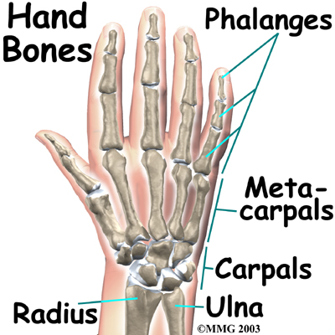
Metacarpals (5)
Consists of 5 bones:
Metacarpals 1-5
Cylindrical, rounded distal ends that form the knuckles
Articulate proximally with carpals and distaly with phalanges

Slide 45
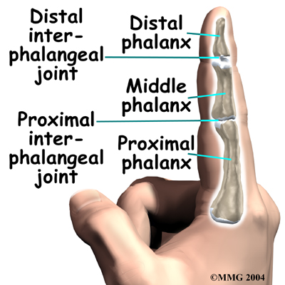
Phalanges (14)
Finger Bones
Each finger has three phalanges (digits)
A proximal, a middle and a distal phalanx (digit)
The Thumb has two-it lacks a middle phalanx

Slide 46
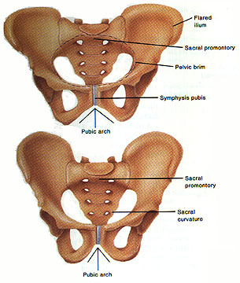
Pelvic Pelvic-Lower Limbs p. 158-161
Pelvic Girdle
Consists of two coxal bones that articulate with each other anteriorly and with the sacrum posteriorly.
Saccrum, Coccyx, and Pelvic Girdle form Pelvis

Slide 47
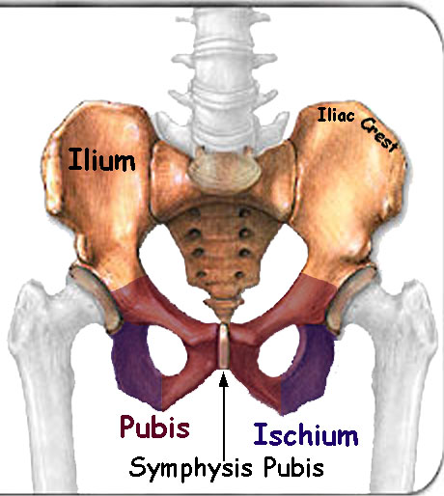
Coxal Bone
Consists of:
Ilium
Ischium
Pubis
Fused in the region of acetabulum

Slide 48
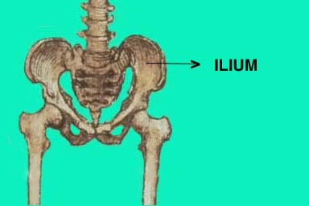
Ilium
Largest portion of coxal bone
Joins the sacrum at the sacroiliac joint

Slide 49
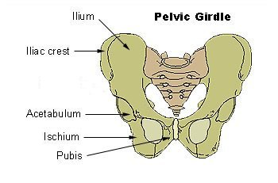
Ischium
Lowest portion of the coxal bone
Supports the body weight when sitting

Slide 50
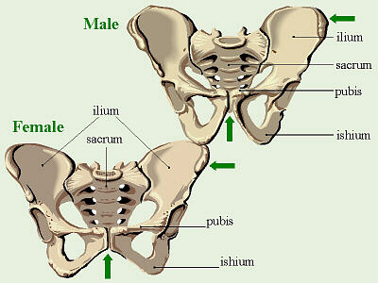
Pubis
Anterior portion of the coxal bone
Fused anteriorly at the symphysis pubis

Slide 51
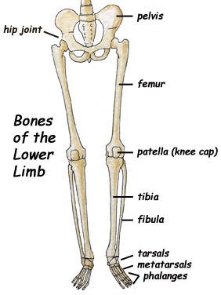
Lower Limb
Provide frameworks for the thigh, leg and foot
Consists of:
Femur
Tibia
Fibula
Foot

Slide 52
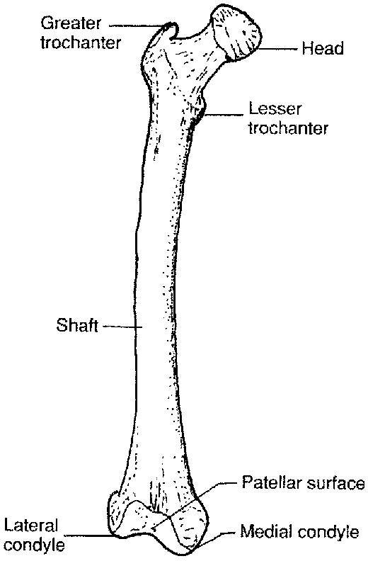
Femur
Extends from hip to the knee
Largest bone in body
Patella articulates with its anterior surface

Slide 53
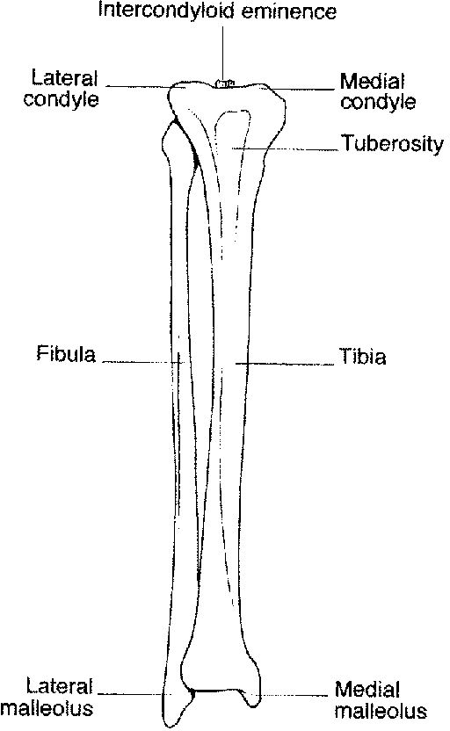
Tibia
Located on the medial side of leg
Articulates with the talus of the ankle

